Slide 1
ACCY577 Machine Learning for Accounting
Module 6: Introduction to Text Analysis
Linden Lu

Slide 2
Lesson 1: Introduction to Text Analytic
Text Tokenization
Remove special characters
Filtering stop words
Stemming
Word Counts
Bag of Word

Slide 3
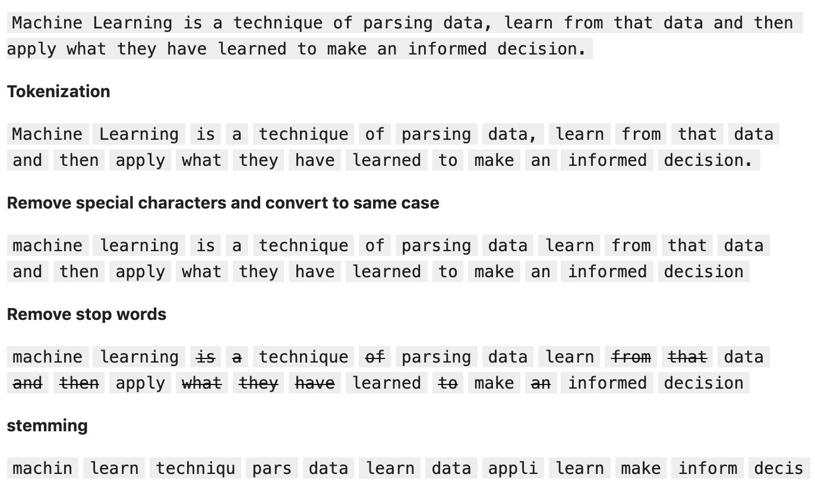
Text Tokenization

Slide 4
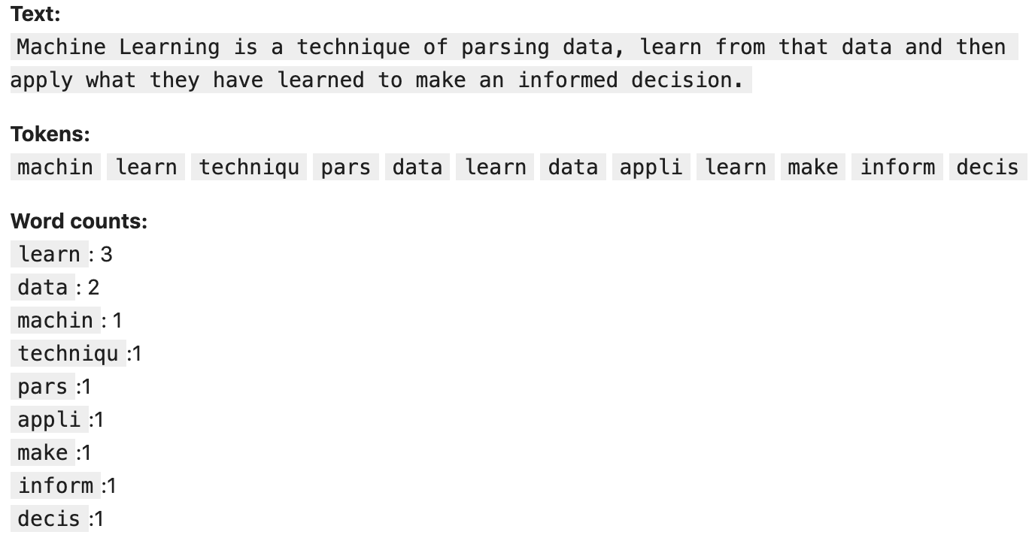
Word Counts

Slide 5
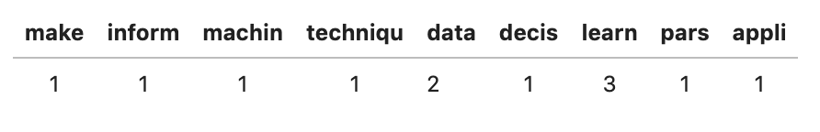
Bag of Words

Slide 6
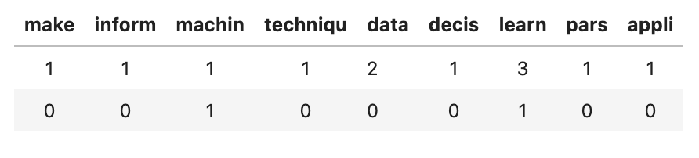
Document Term Matrix(DTM)

Slide 7
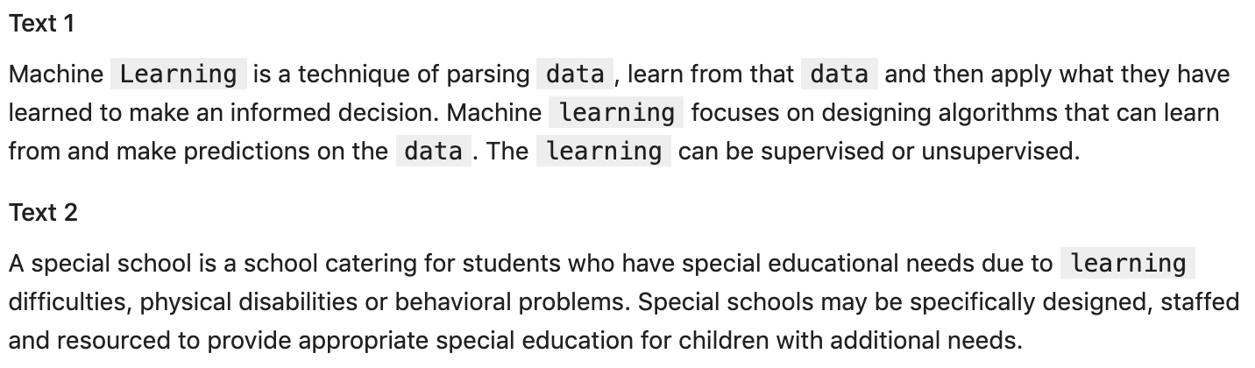
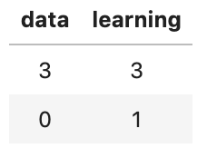
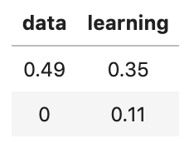
TF-IDF
Regular DTM
TF-DIF DTM
TF-IDF

Slide 8
Lesson 2: Introduction to Text Classification
Data
20 Newsgroup Dataset
Algorithm
Naïve Bayes
Linear SVC
Logistic Regression

Slide 9
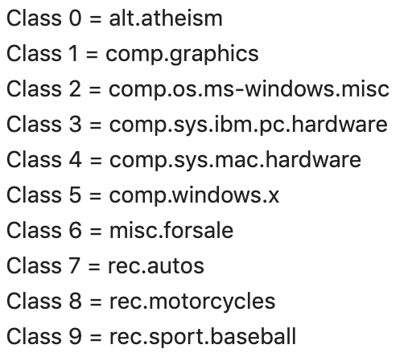
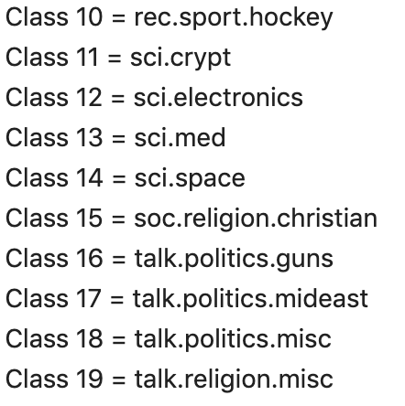
20 Newsgroup Dataset

Slide 10
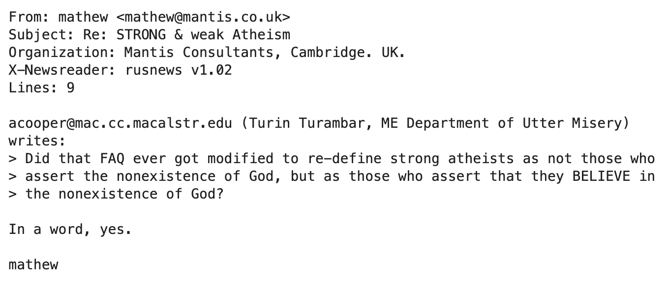
20 Newsgroup Dataset
Sample Message (alt.atheism)

Slide 11
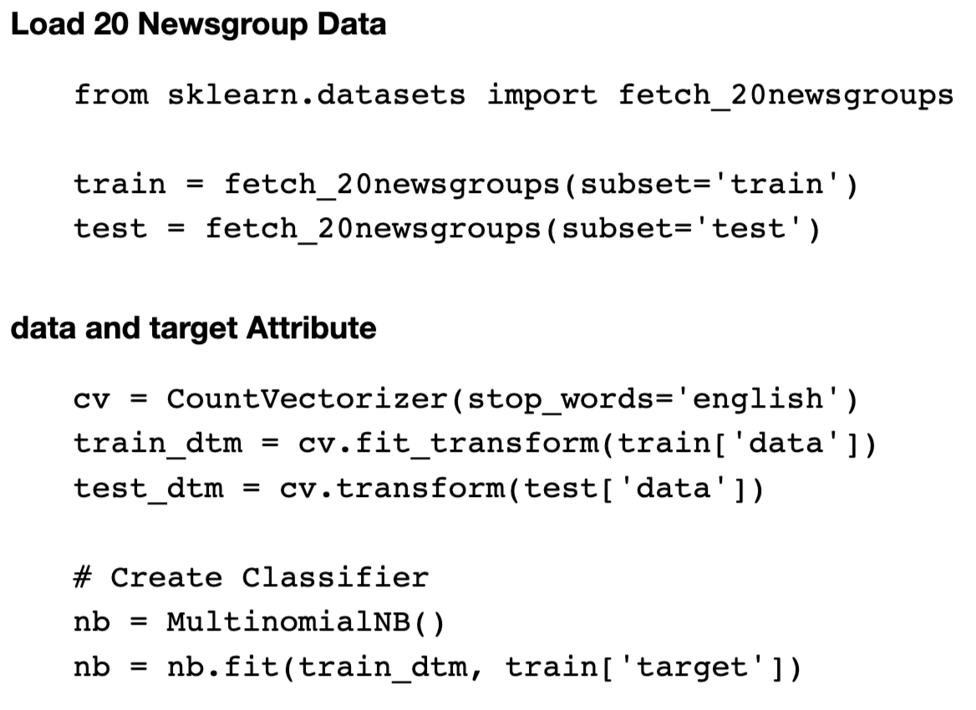
20 Newsgroup Dataset

Slide 12
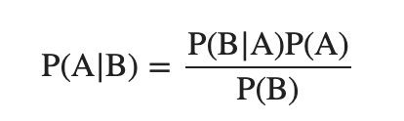
Bayes Theorem
Where A and B are events.
P(A) is the probability of observing event A.
P(B) is the probability of observing event B.
P(A | B) is a conditional probability: the likelihood of event A occurring given that B is true.
P(B | A) is a conditional probability: the likelihood of event B occurring given that A is true.

Slide 13
Bayes Theorem
Cancer Screening Test
10,000 cancer screening test results
1% have cancer
80% cancer patients tested positive
5% healthy people tested positive
Question
What's the likelihood of a person to have cancer if tested positive.

Slide 14
Bayes Theorem
1% has cancer: 10000 x 0.01 = 100 have cancer, 9900 don’t
Predicted Positive: 100 x 0.8 + 9900 x 0.05 = 80 + 495 = 575
True positive among predicted positive: 80
Probability to have cancer if tested positive: 80/575 = 14%

Slide 15
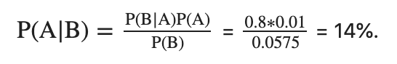
Bayes Theorem
Event A is has the cancer, P(A): 1%
Event B is test positive, P(B): (80+495)/10000=5.75%.
P(B|A) is the likelihood of testing positive when having the cancer, 80%
P(A|B) is the likelihood of having cancer when tested positive, or the probability we are trying to find out.

Slide 16
Bayes Theorem on Text Classification
A represents a topic, P(A) is the proportion of all messages that are in topic A.
B represents occurrence of a word B, P(B) is the frequency of the word B in the text.
P(B|A) is the likely frequency of the word B appears in the text if the text belongs to the topic A
P(A|B) is the likelihood of a text in topic A given the frequency of word B.

Slide 17
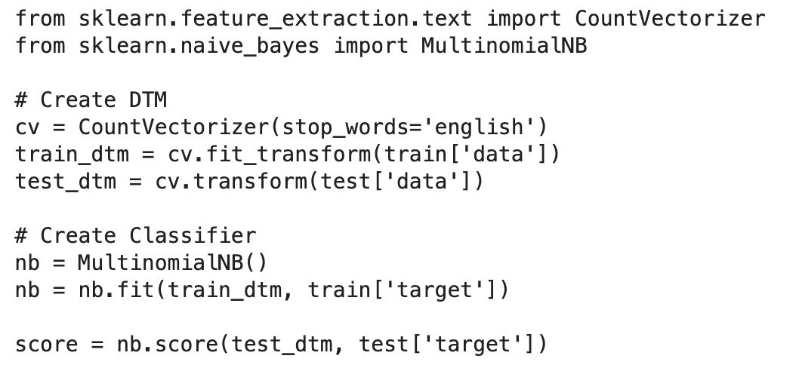
Naïve Bayes Classifier

Slide 18
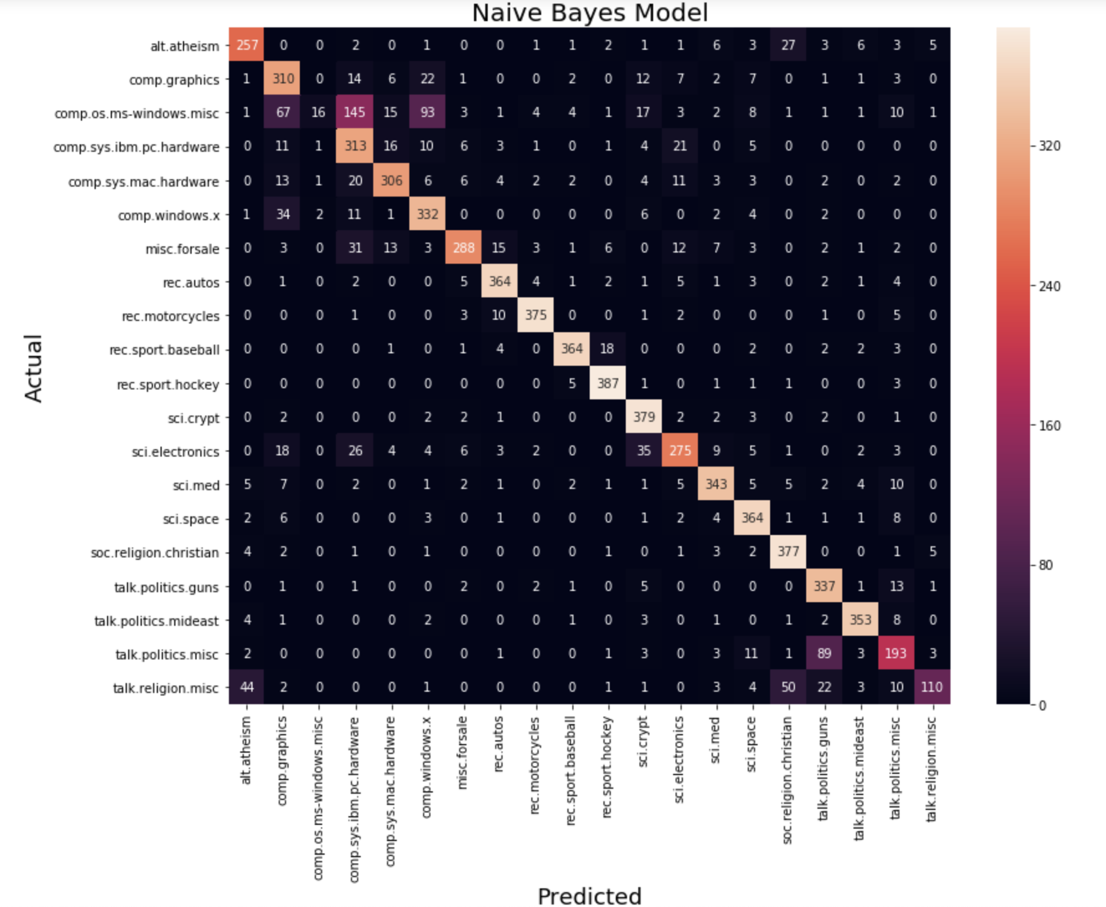
Confusion Matrix

Slide 19
Lesson 3: Introduction to Text Classification II
Explore Classifier
N-Grams
N-Gram Classification
Sentiment Analysis
Stemming

Slide 20
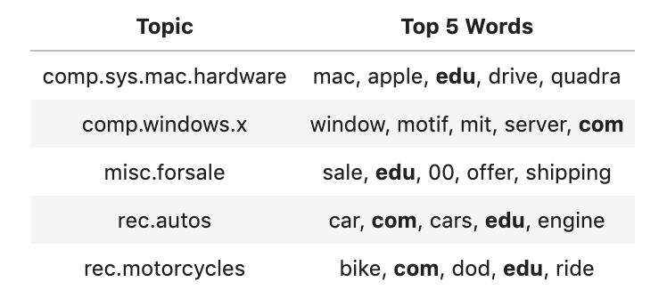
Top Words

Slide 21
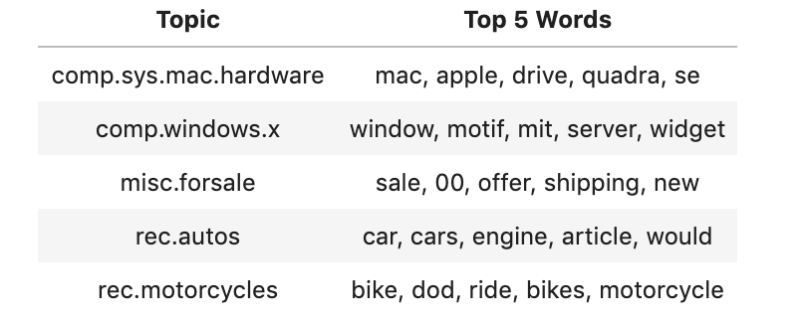
Top Words with Custom Stop Words

Slide 22
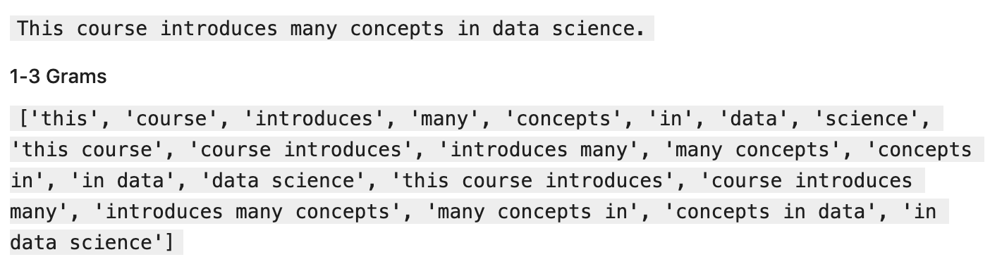
N-Grams

Slide 23
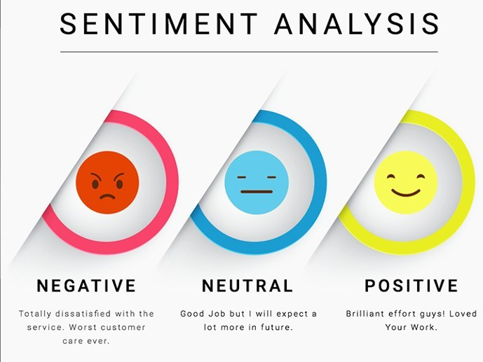
Sentiment Analysis

Slide 24
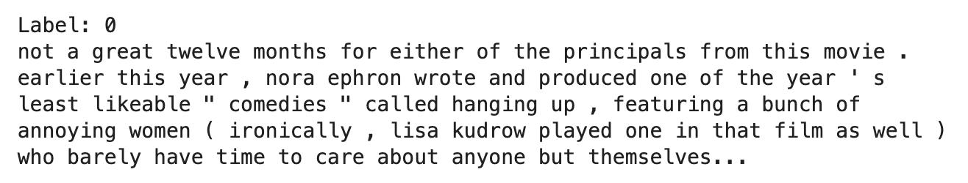
Movie Review Dataset
Built-in in NLTK
2000 movie reviews
1000 positive, 1000 negative
Sample Review(Negative)

Slide 25
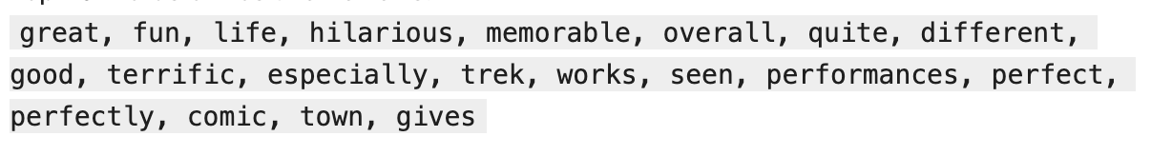
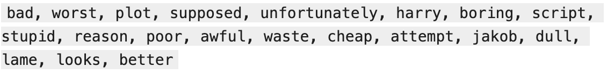
Top Words
Positive Reviews
Negative Reviews

Slide 26
Stemming
Not supported by default
Define custom tokenize function with PotterStemmer
Slow down training process
Improve accuracy

Slide 27
Module 6 Review
Text Data Pre-Process
stop words
stemming
Document term matrix(DTM)
TF-IDF
Text Classification
Naive Bayes
Support Vector Machine
Logistic Regression
Sentiment Analysis

